Slide 1
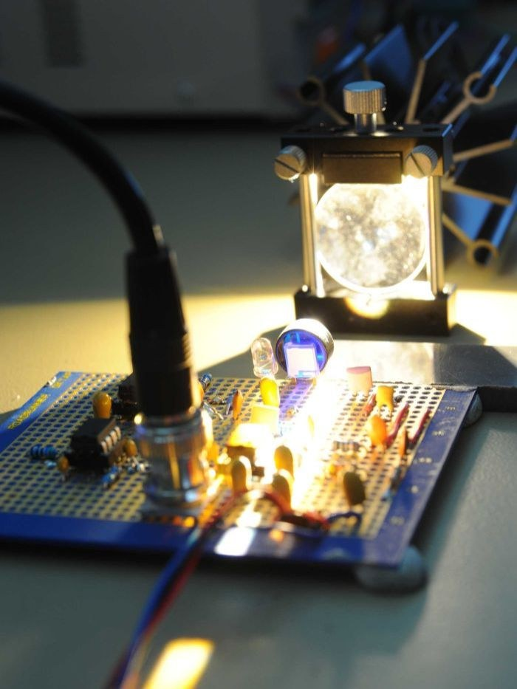
LIFI : SMART TOLL COLLECTION SYSTEM
Capstone Project Proposal
Submitted By:
(102003130) Arpit Sagar
(102003171) Manpreet Singh
(102003177) Sanchita Bora
(102003183) Anshika
(102003188) Medhansh Singh Verma
CPG NO.52
Mentor:Dr.Sharad Saxena

Slide 2
PROJECT OVERVIEW
To implement automatic system of toll collection using LiFi(Light Fidelity), eliminating conventional methods and enhancing speed and accuracy in context of Toll Collection.
Offering a faster alternative, LiFi equipped vehicle system enables toll fee collection when the vehicle passes under the toll booth while automatically updating vehicle information and transaction on interactive user-friendly app.
To demonstrate a faster frequency and more secure optimal solution, this project focuses on data transmission through light using the LiFi setup(transmitter and receiver) with the wider application useful for the existing scenario of toll collection.
LiFi with the feature of being bidirectional, high speed and fully networked wireless communication permits us to integrate this efficient technology for toll collection system.

Slide 3
NEED ANALYSIS
INCREASED EFFICIENCY
REDUCED CONGESTION
Faster and more efficient transactions
Eliminating the need for physical toll booths
IMPROVED ACCURACY
INCREASED SAFETY
Real time monitoring helping reduce errors
Reduce the risk of accidents at toll plazas

Slide 4
LITERATURE SURVEY
Researchers have conducted several studies on Li-Fi-based toll systems, including:
Haas et al. demonstrated the feasibility of using Li-Fi for wireless communication in a car park management system in 2013.
Wang et al. proposed a Li-Fi-based toll collection system for urban expressways in 2016.
Li et al. developed a Li-Fi-based smart toll gate system that could automatically detect vehicle information and process toll payments in 2017.
Le et al. proposed a Li-Fi-based vehicle detection system for toll gates that utilized a neural network to classify vehicle types in 2018.
Asadzadeh et al. proposed a Li-Fi-based system for vehicle-to-vehicle communication in 2019.
These studies have shown that Li-Fi is a viable technology for toll systems with high-speed data transmission and accurate vehicle detection. It can potentially eliminate toll booths and ease traffic.

Slide 5
PROBLEM STATEMENT
PROBLEM
SOLUTION
Current RFID and barcode scanning systems have limitations in accuracy, speed, and security
Li-Fi technology offers faster data transfer rates, higher accuracy, and enhanced security, improving the transportation experience

Slide 6
OBJECTIVE
The objectives of the project will be as follows:
Real-time toll collection: LiFi-enabled devices in vehicles enable real-time communication with toll gates, improving traffic flow by eliminating the need for stopping and reducing congestion.
Ease of Use, Capacity and Availability: Li-Fi technology's vast and fast spectrum enables automatic toll payment processing, tracking and storing toll details, and enhancing data transfer speed, while also being secure and reliable for toll gate systems.

Slide 7
ASSUMPTIONS
Interference-free environment: LiFi technology assumes that the communication environment is free from any interfering light sources.
01
Line-of-sight communication:LiFi assumes that the transmitting and receiving devices have an unobstructed line-of-sight connection to each other.
02

Slide 8
CONSTRAINTS
Limited range: The range of LiFi communication is limited by the power of the LED light source, and the sensitivity of the receiving device.
01
Data transmission speed: While LiFi has the potential to offer high data transmission speeds, the actual speed is limited by the speed of the LED light modulation and the sensitivity of the receiving device.
02

Slide 9
EXECUTION PLAN (METHODOLOGY)
RESEARCH AND IDENTIFICATION | DESIGN AND DEVELOPMENT | INTEGRATION AND LAYOUT
Designing of Prototype. Identification of hardware components. | Circuit and module development. Optimal compatibility arrangement. | Software Processing Automatic Transaction and Data Transmission.

Slide 10
PROJECT REQUIREMENTS
TOOLS/PLATFORMS
LiFi transmitter and receiver circuitry
Prototype car and system setup
Software integration module
Arduino Hub and IOT Cloud Platform

Slide 11
PROJECT OUTCOMES
01
Successful implementation of secure toll collection via LiFi data transfer
Successful data transmission through
light detection
02

Slide 12
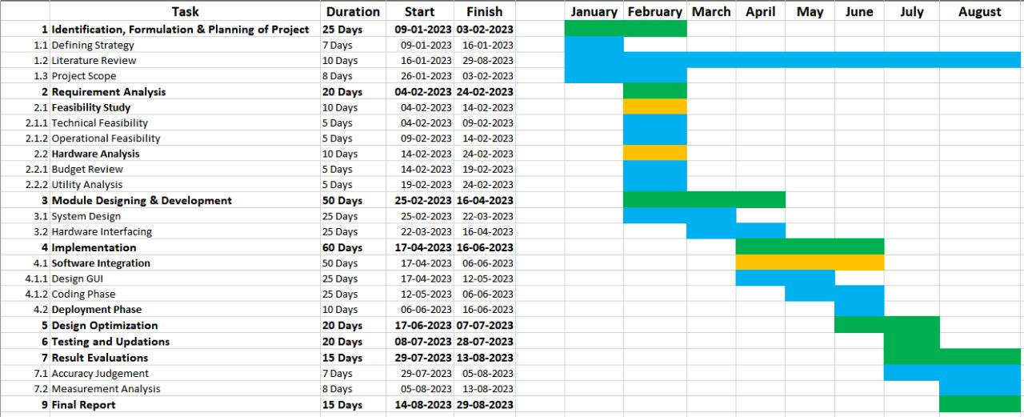
WORK PLAN

Slide 13
Role of Individual Team Members
Task | Contributors
Hardware Implementation | Arpit Sagar, Manpreet Singh
Module Designing and Optimization | Arpit Sagar, Manpreet Singh
IoT Integration | Arpit Sagar, Manpreet Singh
UI Design | Manpreet Singh, Sanchita Bora, Anshika, Medhansh Singh Verma
Backend and DBMS | Sanchita Bora, Anshika, Medhansh Singh Verma
Software Testing | Sanchita Bora, Anshika, Medhansh Singh Verma
Literature Review | Arpit Sagar, Manpreet Singh, Sanchita Bora, Anshika, Medhansh Singh Verma
Documentation | Arpit Sagar, Sanchita Bora, Anshika, Medhansh Singh Verma, Manpreet Singh

Slide 14
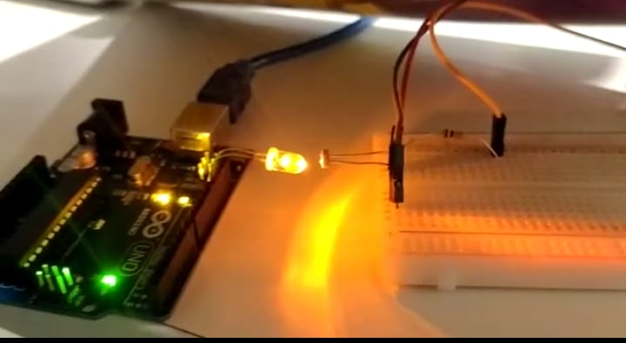
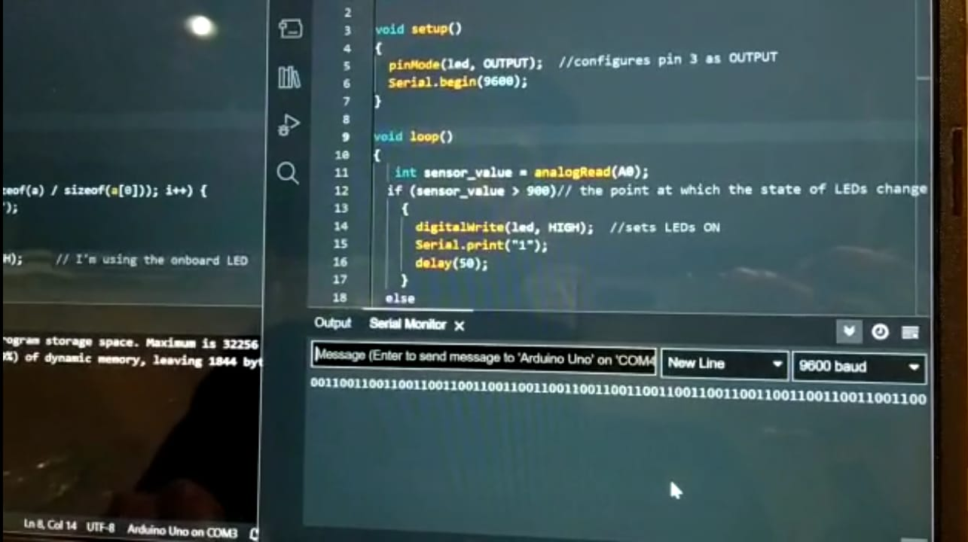
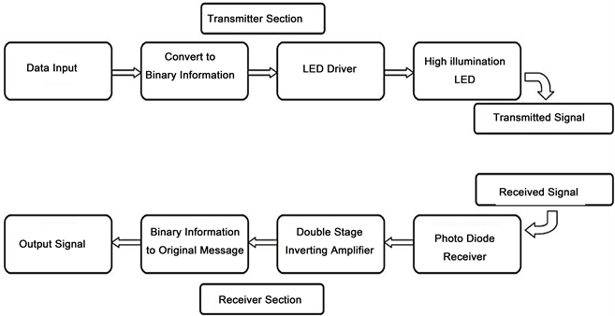

Slide 15
THANK YOU!

